Slide 1
Financial Statements Analytics
Professor Burnes
Leeds School of Business
University of Colorado Boulder
Leeds
B U S I N E S S
Page 1

Slide 2
Example 1: Developing a Year 1 Income Statement ProForma
Please see the modules FinStatement Example.xlsx
The Facts
Last year you had $13,000,000 in revenue
Your goal is to increase revenue (sales) by 25% this year
COGS will remain at 20% of sales
Operating Expenses will remain at 60% of sales
Depreciation will remain constant. What does this mean?
You are in the 40% Tax Bracket
SHOW YOUR YEAR 1 INCOME STATEMENT PRO FORMA
Do NOT show a Pro Forma with decimals. You cannot predict the future that well.

Slide 3
3 Key Areas of Initial Consideration
1
Profitability
2
Operations
3
Capital Structure

Slide 4
Profitability
Are you making money
According to what measure
Please see the Ratio Guide. Let’s calculate the profitability measures relative to the Financial Statements provided

Slide 5
Operations
How effectively are you running your business
How effectively are you utilizing your Assets
Please see the Ratio Guide. Let’s calculate the Operational measures (liquidity and Assets) relative to the Financial Statements provided

Slide 6
Capital Structure
Capital Structure refers to the mix of Debt and Equity used to run a business
ROE
0% Debt implies
100% Equity
100% Debt
% Debt

Slide 7
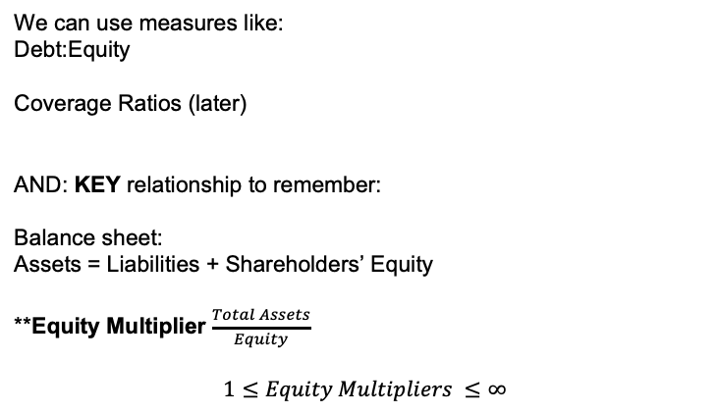
Notes on Capital Structure
We can use measures like:
Debt:Equity
Coverage Ratios (later)
AND: KEY relationship to remember:
Balance sheet:
Assets = Liabilities + Shareholders’ Equity
**Equity Multiplier $\frac{Total Assets}{Equity}$
$$1≤Equity Multipliers ≤∞$$

Slide 8

We have an equation that evaluates
1
Profitability
2
Operations
3
Capital Structure
The Dupont Equation
$$ROE= \frac{Revenue}{Net Income}∗\frac{Net Income}{Assets}∗\frac{Assets}{Equity}$$
Profitability
Asset
Effectiveness
Capital
Structure

Slide 9
As an Equity Holder, what do I think about an infinite multiplier
It makes me really nervous.
That means I have A LOT (LIKE APPROACHING 100%) OF LEVERAGE (DEBT)
This is very risky because I have interest and principal to pay BEFORE shareholders (equity holders) get paid

Slide 10
Example, Please see ESBM4570_4.2.xlsx
Let’s work through the Income Statement and Balance Sheet.
From Here, we can work through the ANALYTICS.

Slide 11
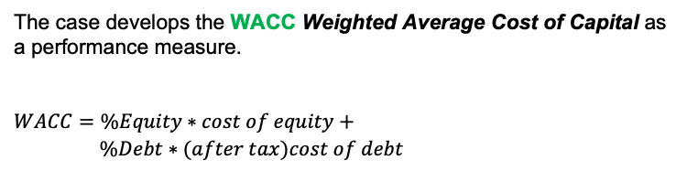
Cost of Capital
Cost of Capital (interest rate) is influenced by:
Project (see Scorecard!)
Market
Capital Structure
As you prepare for Bobs Baloney
The case develops the WACC Weighted Average Cost of Capital as a performance measure.
$$WACC=\%Equity∗cost of equity+$$
$\%Debt∗(after tax)cost of debt$

Slide 12
As you prepare for Monday
Using the Spreadsheets provided (in case) prepare to discuss:
DuPont Elements over Time
DuPont Ratio over Time
Where does Bobs fit relative to comparables (benchmarks)
What about ROA? Does decline mean “bad” ROA?
Mino’s statement and its credibility

